Slide 1
Probabilistic Graphical Model
Most slides come from http://www.inf.ed.ac.uk/teaching/courses/asr/2020-21/asr05-hmm-algorithms.pdf
Ying shen
School of software engineering
Tongji university

Slide 2
Content
Introduction to HMMs: Hidden Markov models
HMM for ASR
Likelihood computation (forward algorithm)
Finding the most probable state sequence (Viterbi algorithm)
Estimating the parameters (forward-backward and EM algorithms)
Notes:
https://www.khanacademy.org/computing/computer-science/informationtheory/moderninfotheory/v/markov_chains

Slide 3
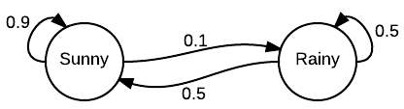
Markov chains
Markov chains were first introduced in 1906 by Andrey Markov, with the goal of showing that the Law of Large Numbers does not necessarily require the random variables to be independent.
A Markov chain is a model that tells us something about the probabilities of sequences of random variables, states, each of which can take on values from some set.
Notes:
The easiest way to explain a Markov chain is by simply looking at one. In this example, we can see we have two states: “sunny” and “rainy”. Let’s say the day is sunny, and we want to know what the chances are that it will be sunny the next day. We can see that the Markov chain indicates that there is a .9, or 90%, chance it will be sunny. Following this pattern, we can see that there will probably be many sunny days lumped together followed by a shorter string of rainy days. It is not certain, but likely.
Obviously, this is not a real world example - this is not how real-world weather models work. However, if one were building a video game that had a “real” weather component, a Markov chain like this may be useful when fed several years of real-time data.

Slide 4
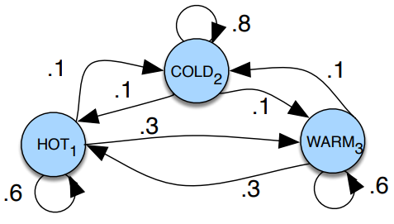
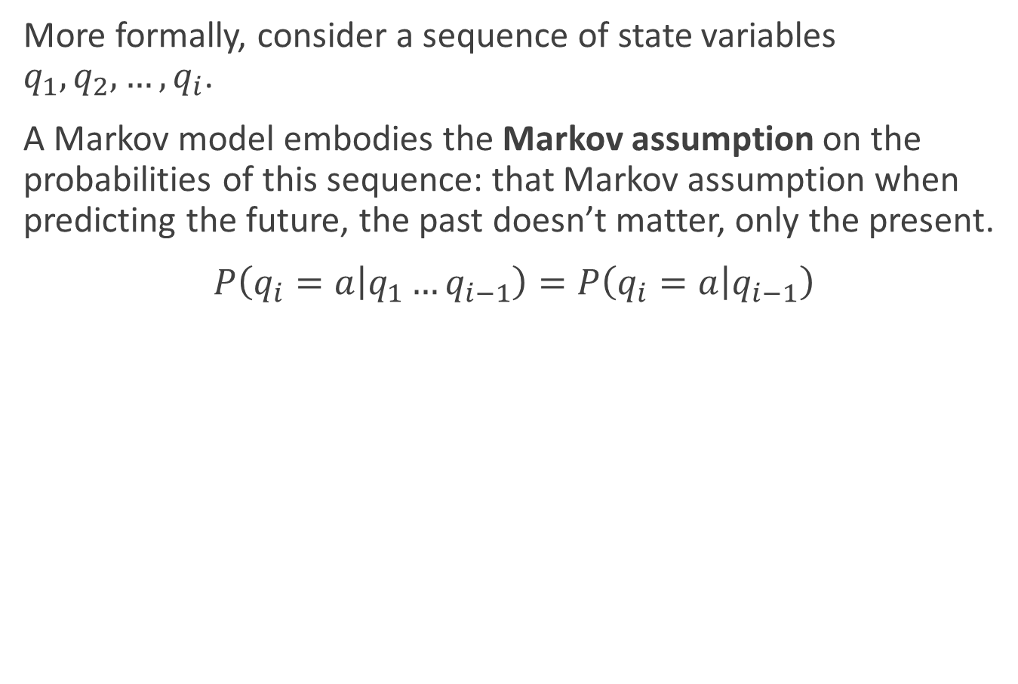
Markov chains
More formally, consider a sequence of state variables $q_{1},q_{2},…,q_{i}$.
A Markov model embodies the Markov assumption on the probabilities of this sequence: that Markov assumption when predicting the future, the past doesn’t matter, only the present.
$P\left(q_{i}=a | q_{1}…q_{i−1}\right)=P\left(q_{i}=a | q_{i−1}\right)$

Slide 5
Markov chains
The states are represented as nodes in the graph, and the transitions, with their probabilities, as edges
The transitions are probabilities: the values of arcs leaving a given state must sum to 1

Slide 6
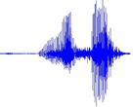


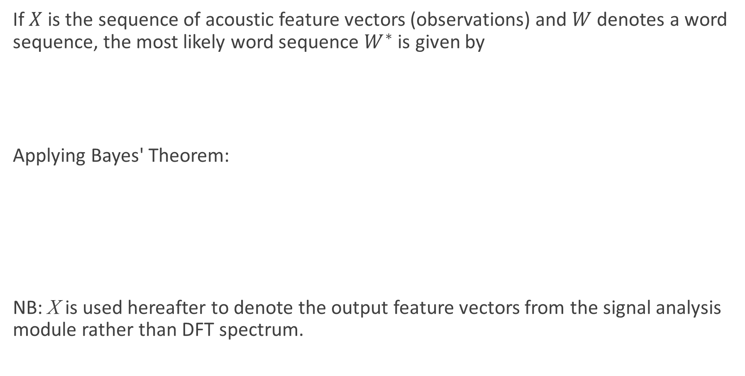

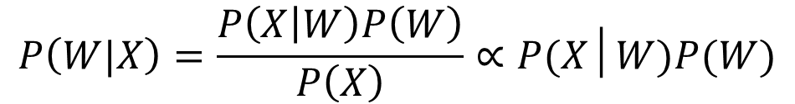

Fundamental Equation of Statistical Speech Recognition
If $X$ is the sequence of acoustic feature vectors (observations) and $W$ denotes a word sequence, the most likely word sequence $W^{∗}$ is given by
Applying Bayes' Theorem:
NB: X is used hereafter to denote the output feature vectors from the signal analysis module rather than DFT spectrum.
$$W^{∗}=\arg{\max_{W}{P\left(W|X\right)}}$$
$$P\left(W|X\right)=\frac{P\left(X | W\right)P\left(W\right)}{P\left(X\right)}∝P(X│W)P(W)$$
$$W^{∗}=\arg{\max_{W}{P\left(X|W\right) P(W)}}$$
Acoustic model
Language model
Speech Recognition
今天天气很好
$$X$$
$$W^{∗}$$

Slide 7
Acoustic Modelling
Decoded Text
(Transcription)
Recorded Speech
Hidden Markov model
Signal Analysis
Acoustic Model
Search Space
Language Model
Training Data

Slide 8









Hierarchical modelling of speech
今天天气很好
语言模型
$$P\left(W\right)$$
—N-gram
词序列
今天
天气
很
好
j
in1
t
ian1
t
ian1
q
i4
h
en3
h
ao3
音素序列
声学模型
$$P\left(O | W\right)$$
—HMM
状态序列
$$s1$$
$$s2$$
$$s3$$
$$s4$$
$$s5$$
特征序列
$$O$$
……
时间$t$

Slide 9






Hierarchical modelling of speech
今天天气很好
今天
天气
很
好
j
in1
t
ian1
t
ian1
q
i4
h
en3
h
ao3
$$s_{1}$$
$$s_{2}$$
$$s_{3}$$
…
$$s_{1}$$
$$s_{2}$$
$$s_{3}$$

Slide 10
Content
Introduction to HMMs: Hidden Markov models
HMM for ASR
Likelihood computation (forward/backward algorithm)
Finding the most probable state sequence (Viterbi algorithm)
Estimating the parameters (forward-backward and EM algorithms)

Slide 11
The Hidden Markov Model
A statistical model for time series data with a set of discrete states (1,…, J) (we index them by j or k)
At each time step t:
the model is in a fixed state q_{t} .
the model generates an observation, x_{t} , according to a probability distribution that is specific to the state
We don’t actually observe which state the model is in at each time step – hence “hidden”
Observations can be either continuous or discrete (usually the former)

Slide 12







HMM probabilities
Imagine we know the state at a given time step $t$, $q_{t}=k$
Then the probability of being in a new state, $j$ at the next time step, is dependent only on $q_{t}$ . This is the Markov assumption.
Alternatively: $q_{t+1}$ is conditionally independent of $q_{1}, . . . , q_{t−1}$, given $q_{t}$
$$q_{t−1}$$
$$q_{t}$$
$$q_{t+1}$$
$$x_{t−1}$$
$$x_{t}$$
$$x_{t−1}$$

Slide 13






HMM assumptions
Note that observation independence is an assumption that naturally arises from the model: the probability of $x_{t}$ depends only on the state that generated it, $q_{t}$ .
$$P(q_{t}|q_{t−1})$$
$$P(q_{t+1}|q_{t})$$
$$q_{t−1}$$
$$q_{t}$$
$$q_{t+1}$$
$$p(x_{t}|q_{t−1})$$
$$p(x_{t}|q_{t})$$
$$p(x_{t+1}|q_{t+1})$$
$$x_{t−1}$$
$$x_{t}$$
$$x_{t−1}$$

Slide 14
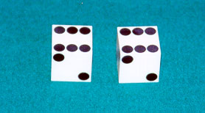
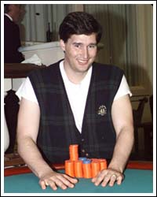
HMM
Example: The dishonest casino
A casino has two dice:
Fair die
P(1) = P(2) = P(3) = P(4) = P(5) = P(6) = 1/6
Loaded die
P(1) = P(2) = P(3) = P(4) = P(5) = 1/10
P(6) = 1/2
Casino player switches between fair and loaded die with probability 1/20 at each turn

Slide 15
HMM
Game
You bet $1
You roll (always with a fair die)
Casino player rolls (maybe with fair die, maybe with loaded die)
Highest number wins $2

Slide 16
Question # 1 – Decoding
GIVEN
A sequence of rolls by the casino player
QUESTION
What portion of the sequence was generated with the fair die, and what portion with the loaded die?
This is the DECODING question in HMMs
1245526462146146136136661664661636616366163616515615115146123562344
FAIR
LOADED
FAIR

Slide 17
Question # 2 – Likelihood
GIVEN
A sequence of rolls by the casino player
QUESTION
How likely is this sequence, given our model of how the casino works?
This is the LIKELIHOOD problem in HMMs
1245526462146146136136661664661636616366163616515615115146123562344
Prob = 1.3 x 10⁻³⁵

Slide 18
Question # 3 – Training
GIVEN
A sequence of rolls by the casino player
QUESTION
How “loaded” is the loaded die? How “fair” is the fair die? How often does the casino player change from fair to loaded, and back?
This is the TRAINING question in HMMs
1245526462146146136136661664661636616366163616515615115146123562344
Prob(6) = 64%

Slide 19
The dishonest casino model
0.05
0.95
0.95
FAIR
LOADED
0.05
P(1|F) = 1/6
P(2|F) = 1/6
P(3|F) = 1/6
P(4|F) = 1/6
P(5|F) = 1/6
P(6|F) = 1/6
P(1|L) = 1/10
P(2|L) = 1/10
P(3|L) = 1/10
P(4|L) = 1/10
P(5|L) = 1/10
P(6|L) = 1/2

Slide 20
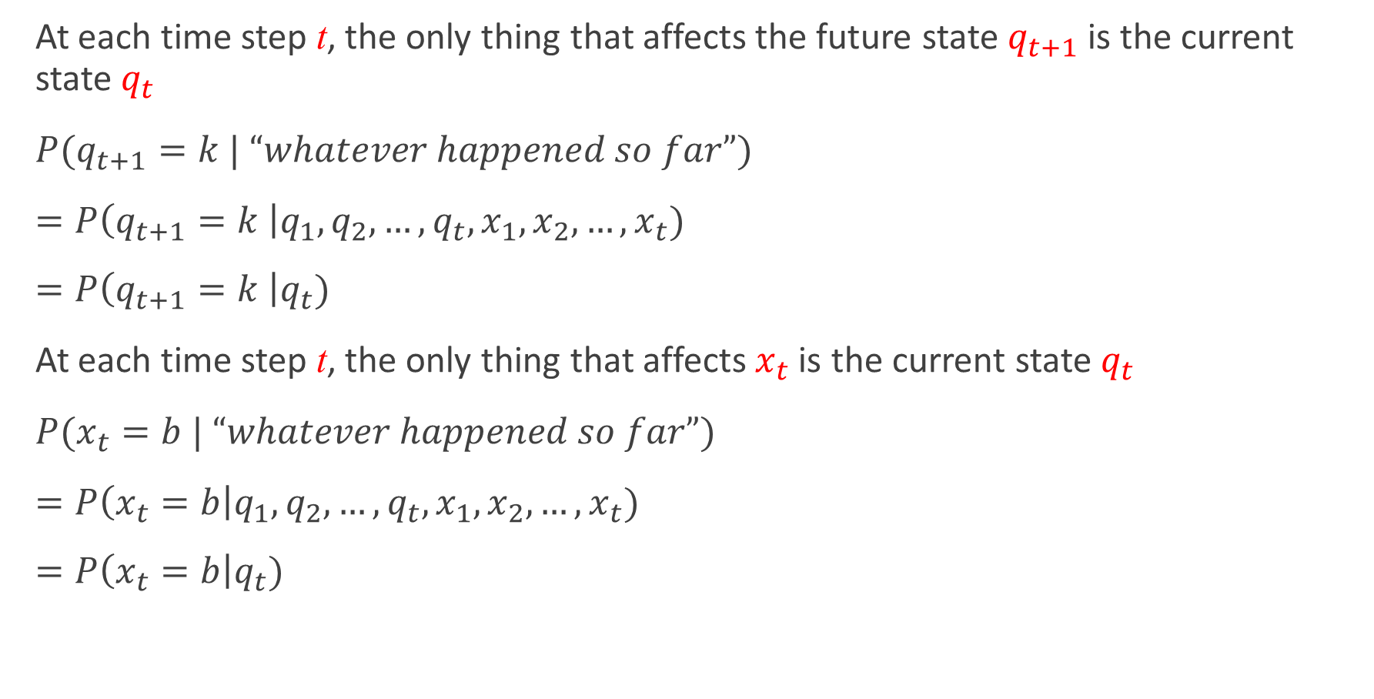
An HMM is memoryless
At each time step t, the only thing that affects the future state $q_{t+1}$is the current state $q_{t}$
$P(q_{t+1}=k | “whatever happened so far”)$
$=P\left(q_{t+1}=k \right|q_{1}, q_{2},…,q_{t},x_{1}, x_{2}, …, x_{t})$
$=P\left(q_{t+1}=k \right|q_{t})$
At each time step t, the only thing that affects $x_{t}$ is the current state $q_{t}$
$P(x_{t}=b | “whatever happened so far”)$
$=P\left(x_{t}=b\right|q_{1}, q_{2},…,q_{t},x_{1}, x_{2}, …, x_{t})$
$=P\left(x_{t}=b\right|q_{t})$
1
2
K
…

Slide 21
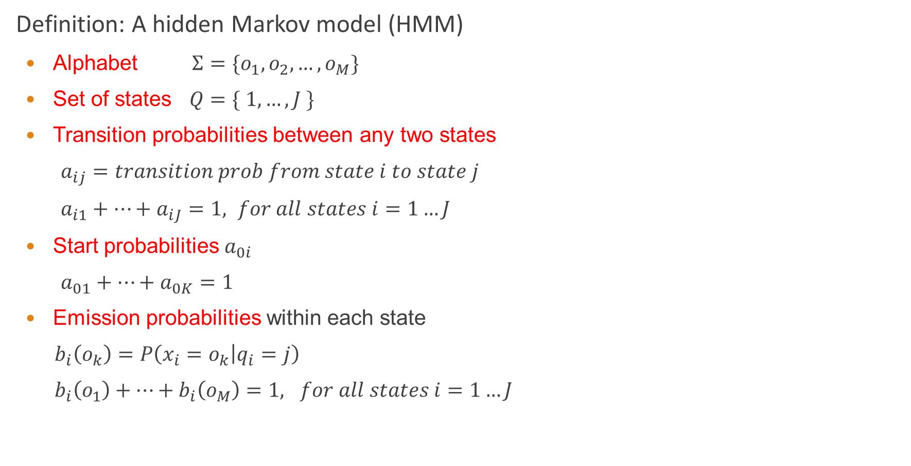
Definition of HMM
Definition: A hidden Markov model (HMM)
Alphabet $Σ=\{o_{1}, o_{2}, …, o_{M}\}$
Set of states $Q=\{ 1, …, J \}$
Transition probabilities between any two states
$a_{ij}=transition prob from state i to state j$
$a_{i1}+…+a_{iJ}=1, for all states i=1…J$
Start probabilities $a_{0i}$
$a_{01}+…+a_{0K}=1$
Emission probabilities within each state
$b_{i}\left(o_{k}\right)=P\left(x_{i}=o_{k} | q_{i}=j\right)$
$b_{i}\left(o_{1}\right)+…+b_{i}\left(o_{M}\right)=1, for all states i=1…J$
1
2
K
…

Slide 22





A parse of a sequence
Given a sequence $x=x_{1}…x_{N}$,
A parse of x is a sequence of states $Q=q_{1},…,q_{N}$
1
1
1
1
…
1
2
2
2
2
2
…
2
…
…
…
…
K
K
K
K
…
K
$$x_{1}$$
$$x_{2}$$
$$x_{3}$$
$$x_{N}$$

Slide 23







Generating a sequence by the model
Given a HMM, we can generate a sequence of length N as follows:
Start at state $q_{1}$ according to prob $a_{0q_{1}}$
Emit letter $x_{1}$ according to prob $b_{q_{1}}(x_{1})$
Go to state $q_{2}$ according to prob $a_{q_{1}q_{2}}$
… until emitting $x_{N}$
1
1
1
1
…
1
$$a02$$
2
2
2
2
2
…
2
0
…
…
…
…
K
K
K
K
…
K
$$b2(x1)$$
$$x_{1}$$
$$x_{2}$$
$$x_{3}$$
$$x_{N}$$

Slide 24

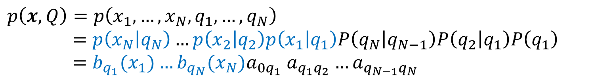




Likelihood of a parse
Given a sequence $x=x_{1}…x_{N}$ and a parse $Q=q_{1},…q_{N}$,
To find how likely this scenario is: (given our HMM)
$$p\left(x, Q\right)=p\left(x_{1}, …, x_{N}, q_{1}, …, q_{N}\right)$$
$$=p\left(x_{N} | q_{N}\right)…p\left(x_{2} | q_{2}\right)p\left(x_{1} | q_{1}\right)P\left(q_{N} | q_{N−1}\right)P\left(q_{2} | q_{1}\right)P\left(q_{1}\right)$$
$$=b_{q_{1}}(x_{1})…b_{q_{N}}(x_{N})a_{0q_{1}} a_{q_{1}q_{2}}…a_{q_{N−1}q_{N}}$$
1
1
1
1
…
1
2
2
2
2
2
…
2
…
…
…
…
K
K
K
K
K
…
$$x_{1}$$
$$x_{2}$$
$$x_{3}$$
$$x_{N}$$

Slide 25
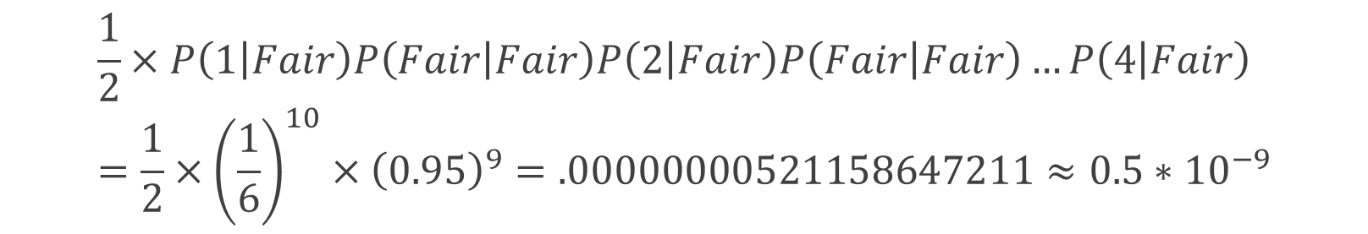
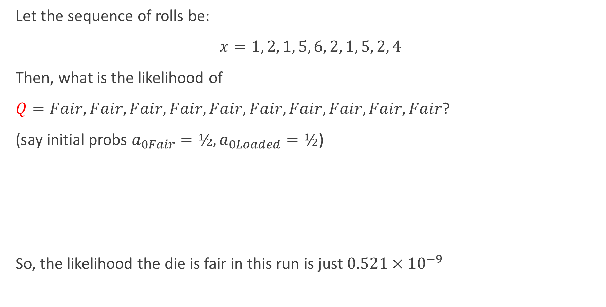
Example: the dishonest casino
Let the sequence of rolls be:
$x=1, 2, 1, 5, 6, 2, 1, 5, 2, 4$
Then, what is the likelihood of
$Q=Fair, Fair, Fair, Fair, Fair, Fair, Fair, Fair, Fair, Fair$?
(say initial probs $a_{0Fair}=½, a_{0Loaded}=½$)
So, the likelihood the die is fair in this run is just $0.521×{10}^{−9}$
$$\frac{1}{2}×P\left(1 | Fair\right)P\left(Fair | Fair\right)P\left(2 | Fair\right)P\left(Fair | Fair\right)…P\left(4 | Fair\right)=\frac{1}{2}×{\left(\frac{1}{6}\right)}^{10}×{\left(0.95\right)}^{9}=.00000000521158647211≈0.5∗{10}^{−9}$$

Slide 26
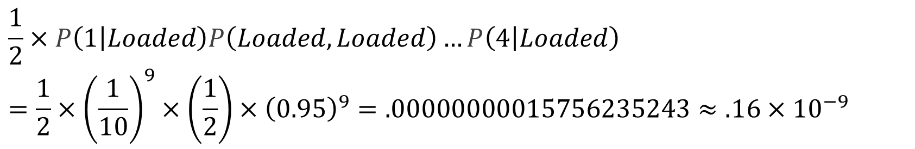
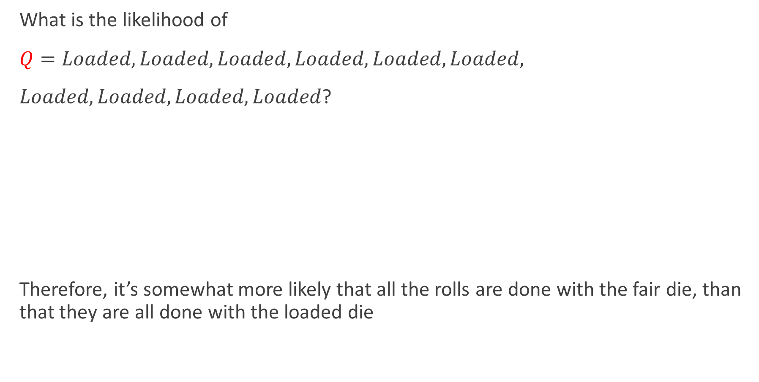
Example: the dishonest casino
What is the likelihood of
$Q=Loaded, Loaded, Loaded, Loaded, Loaded, Loaded,$
$Loaded, Loaded, Loaded, Loaded$?
Therefore, it’s somewhat more likely that all the rolls are done with the fair die, than that they are all done with the loaded die
$$\frac{1}{2}×P\left(1 | Loaded\right)P\left(Loaded, Loaded\right)…P\left(4 | Loaded\right)$$
$$=\frac{1}{2}×{\left(\frac{1}{10}\right)}^{9}×\left(\frac{1}{2}\right)×{\left(0.95\right)}^{9}=.00000000015756235243≈.16×{10}^{−9}$$

Slide 27

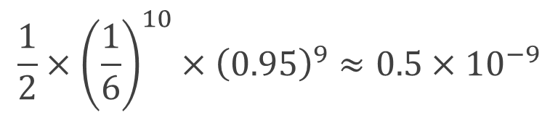
Example: the dishonest casino
Let the sequence of rolls be:
$x=1, 6, 6, 5, 6, 2, 6, 6, 3, 6$
Now, what is the likelihood $π=F, F, …, F$?
same as before
What is the likelihood $Q=L, L, …, L$?
So, it is 100 times more likely the die is loaded
$$\frac{1}{2}×{\left(\frac{1}{6}\right)}^{10}×{\left(0.95\right)}^{9}≈0.5×{10}^{−9}$$
$$\frac{1}{2}×{\left(\frac{1}{10}\right)}^{4}×{\left(\frac{1}{2}\right)}^{6}×{\left(0.95\right)}^{9}=.00000049238235134735≈0.5×{10}^{−7}$$

Slide 28
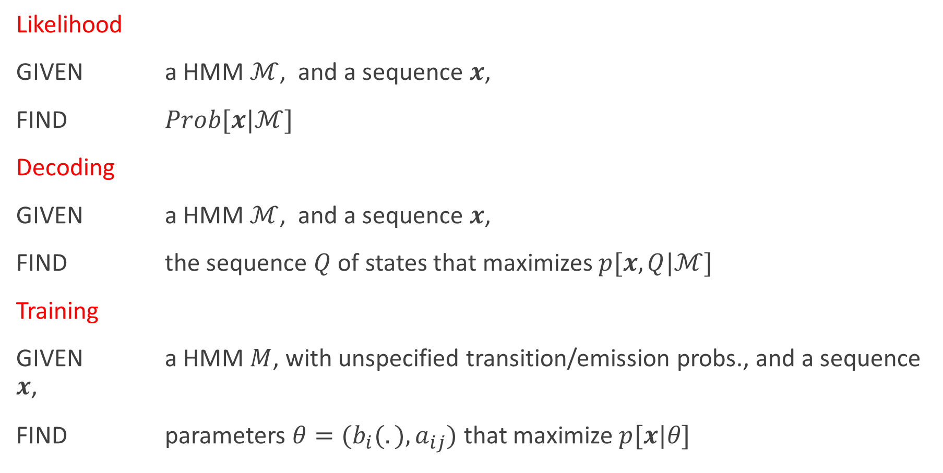
The three main questions on HMMs
Likelihood
GIVEN a HMM $ℳ$, and a sequence $x$,
FIND $Prob[x|ℳ]$
Decoding
GIVEN a HMM $ℳ$, and a sequence $x$,
FIND the sequence $Q$ of states that maximizes $p[x, Q|ℳ]$
Training
GIVEN a HMM $M$, with unspecified transition/emission probs., and a sequence $x$,
FIND parameters $θ=(b_{i}(.), a_{ij})$that maximize $p[x|θ]$

Slide 29



















HMM topologies
The HMM topology determines the set of allowed transitions between states
In principle any topology is possible
$$a_{33}$$
$$a_{11}$$
$$a_{12}$$
$$a_{23}$$
$$2$$
$$1$$
$$3$$
$$a_{14}$$
$$a_{43}$$
$$a_{15}$$
$$4$$
$$a_{37}$$
$$a_{71}$$
$$5$$
$$a_{56}$$
$$a_{67}$$
$$7$$
$$6$$
$$a_{76}$$

Slide 30



Example topologies
Speech recognition: left-to-right HMM with 3~5 states
Speaker recognition: ergodic HMM
left−to−right model
parallel path left−to−right model
ergodic model
$$\left(\begin{matrix}a_{11} & a_{12} & \begin{matrix}a_{13} & 0 & 0\end{matrix} \\ 0 & a_{22} & \begin{matrix}a_{23} & a_{24} & 0\end{matrix} \\ 0 & 0 & \begin{matrix}a_{33} & a_{34} & a_{35}\end{matrix} \\ 0 & 0 & \begin{matrix} 0 & a_{44} & a_{45}\end{matrix} \\ 0 & 0 & \begin{matrix}0 & 0 & a_{55}\end{matrix}\end{matrix}\right)$$
$$\left(\begin{matrix}a_{11} & a_{12} & 0 \\ 0 & a_{22} & a_{23} \\ 0 & 0 & a_{33}\end{matrix}\right)$$
$$\left(\begin{matrix}a_{11} & a_{12} & \begin{matrix}a_{13} & a_{14}\end{matrix} \\ a_{21} & a_{22} & \begin{matrix}a_{23} & a_{24}\end{matrix} \\ a_{31} & a_{23} & \begin{matrix}a_{33} & a_{34}\end{matrix} \\ a_{41} & a_{42} & \begin{matrix}a_{43} & a_{44}\end{matrix}\end{matrix}\right)$$

Slide 31
HMMs for ASR
We generally model words or phones with a left-to-right topology with self loops.
r
ai
t

Slide 32
HMMs for ASR
Traditional HMMs for ASR tend to model each phone with three distinct states (this also enforces a minimum phone duration of three frames of observations)
r1
r2
r3
ai1
ai2
ai3
t1
t2
t3

Slide 33
HMMs for ASR
Traditional HMMs for ASR tend to model each phone with three distinct states (this also enforces a minimum phone duration of three frames of observations)
The phone model topologies can be concatenated to form a HMM for the whole word
r1
r2
r3
ai1
ai2
ai3
t1
t2
t3

Slide 34



HMMs for ASR
Traditional HMMs for ASR tend to model each phone with three distinct states (this also enforces a minimum phone duration of three frames of observations)
This model naturally generates an alignment between states and observations (and hence words/phones).
r1
r2
r3
ai1
ai2
ai3
t1
t2
t3
…..
$$x_{1}$$
$$x_{2}$$
$$x_{3}$$
…..

Slide 35
Content
Introduction to HMMs: Hidden Markov models
HMM for ASR
Likelihood computation (forward algorithm)
Finding the most probable state sequence (Viterbi algorithm)
Estimating the parameters (forward-backward and EM algorithms)

Slide 36
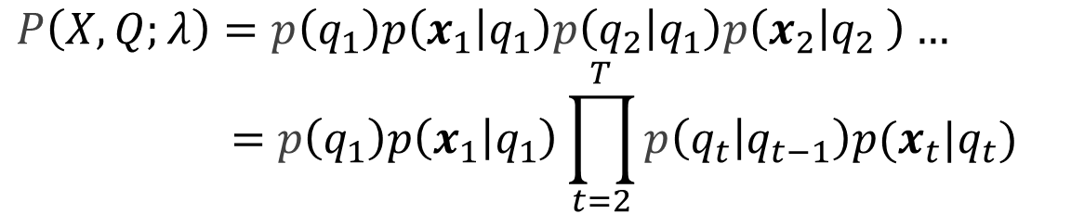
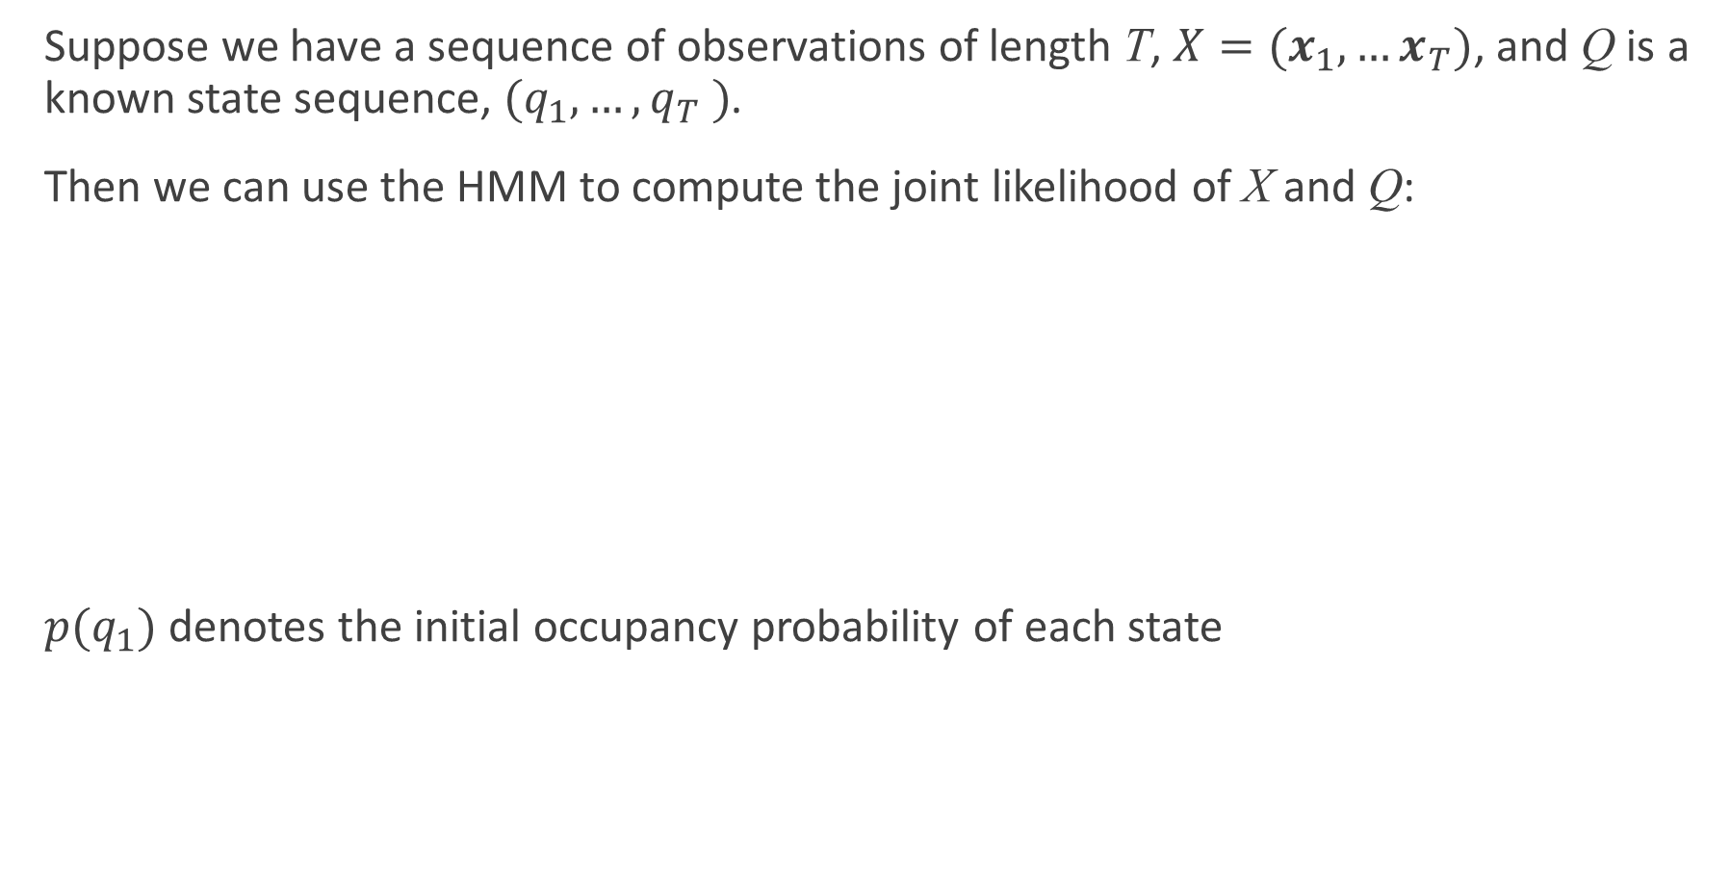
Computing likelihoods with the HMM
Suppose we have a sequence of observations of length T, $X=(x_{1},…x_{T})$, and Q is a known state sequence, $(q_{1},…,q_{T} )$.
Then we can use the HMM to compute the joint likelihood of X and Q:
$p(q_{1})$ denotes the initial occupancy probability of each state
$$P\left(X,Q;λ\right)=p\left(q_{1}\right)p\left(x_{1} | q_{1}\right)p\left(q_{2} | q_{1}\right)p\left(x_{2} | q_{2} \right)…$$
$$=p\left(q_{1}\right)p\left(x_{1} | q_{1}\right)\prod_{t=2}^{T}{p\left(q_{t} | q_{t−1}\right)p(x_{t}|q_{t})}$$

Slide 37

HMM parameters
The parameters of the model, $λ$, are given by:
Transition probabilities $a_{kj}=p\left(q_{t+1}=j\right|q_{t}=k)$
Observation probabilities $b_{j} (x)=p(x|q=j)$

Slide 38

The three problems of HMMs
Working with HMMs requires the solution of three problems:
Likelihood Determine the overall likelihood of an observation sequence $X=(x_{1}, …, x_{t} , …, x_{T})$ being generated by a known HMM topology, $ℳ$.
Decoding and alignment Given an observation sequence and an HMM, determine the most probable hidden state sequence
Training Given an observation sequence and an HMM, find the state occupation probabilities

Slide 39

Computing likelihood
Working with HMMs requires the solution of three problems:
Likelihood Determine the overall likelihood of an observation sequence $X=(x_{1}, …, x_{t} , …, x_{T})$ being generated by a known HMM topology, $ℳ$.
→ the forward algorithm
NB. We do not know the state sequence!

Slide 40

Notes on the HMM topology
By the HMM topology, $ℳ$, we can mean:
A restricted left-to-right topology based on a known word/sentence, leading to a “trellis-like” structure over time
A much less restricted topology based on a grammar or language model – or something in between
Some algorithms are not (generally) suitable for unrestricted topologies

Slide 41












Example: trellis for a 3-state phone HMM
state
$$E$$
$$r_{1}$$
$$r_{2}$$
$$r_{3}$$
$$I$$
time
$$x_{1}$$
$$x_{2}$$
$$x_{3}$$
$$x_{4}$$
$$x_{5}$$
$$x_{6}$$
$$x_{7}$$

Slide 42



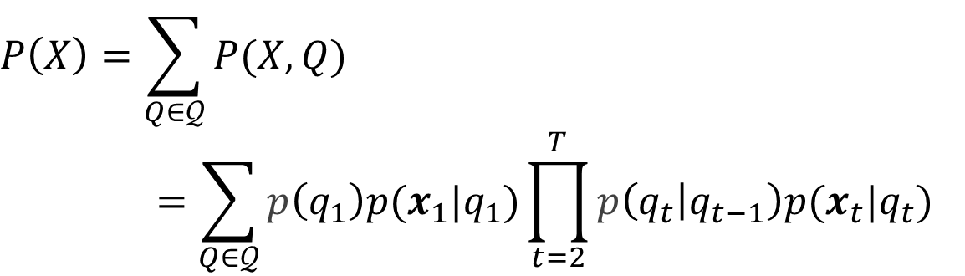













Likelihood
Goal: determine $P(X)$
Sum over all possible state sequences $Q=(q_{1}, …, q_{T})$ that could result in the observation sequence $X$
$$P\left(X\right)=\sum_{Q∈𝒬}{P(X,Q)}$$
$$=\sum_{Q∈𝒬}{p\left(q_{1}\right)p(x_{1}|q_{1})\prod_{t=2}^{T}{p\left(q_{t} | q_{t−1}\right)p(x_{t}|q_{t})}}$$
$$p(q_{2}|q_{1})$$
$$p(q_{3}|q_{2})$$
$$p(q_{T−1}|q_{T})$$
$$q_{1}$$
$$q_{2}$$
…
$$q_{T−1}$$
$$q_{T}$$
$$p(x_{1}|q_{1})$$
$$p(x_{2}|q_{2})$$
$$p(x_{T−1}|q_{T−1})$$
$$p(x_{T}|q_{T})$$
$$x_{1}$$
$$x_{2}$$
$$x_{T−1}$$
$$x_{T}$$

Slide 43

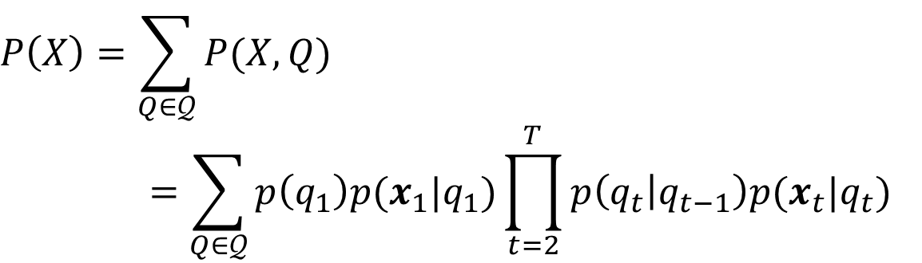

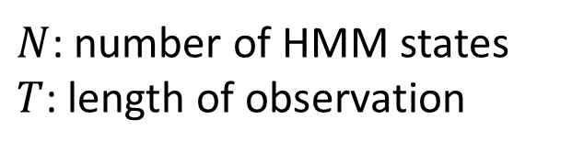
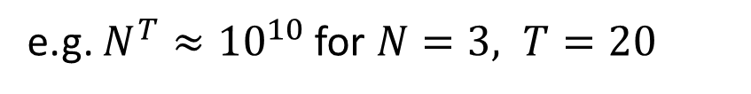
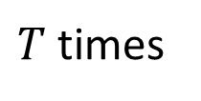
Likelihood
Goal: determine $P(X)$
Sum over all possible state sequences $Q=(q_{1}, …, q_{T})$ that could result in the observation sequence $X$
How many paths $Q$ do we have to calculate?
Computation complexity of multiplication: $O(2TN^{T})$
$$P\left(X\right)=\sum_{Q∈𝒬}{P(X,Q)}$$
$$=\sum_{Q∈𝒬}{p\left(q_{1}\right)p(x_{1}|q_{1})\prod_{t=2}^{T}{p\left(q_{t} | q_{t−1}\right)p(x_{t}|q_{t})}}$$
$$\sim N×N×…×N=N^{T}$$
$N$: number of HMM states
$T$: length of observation
$T$ times
e.g. $N^{T}≈{10}^{10}$ for $N=3, T=20$

Slide 44

Likelihood
Goal: determine $P(X)$
Sum over all possible state sequences $Q=(q_{1}, …, q_{T})$ that could result in the observation sequence $X$
Instead:$P\left(X\right)=\sum_{j=1}^{J}{p(X_{T},q_{T}=j)}=\sum_{j=1}^{J}{α_{T}^{j}}$
$α_{T}^{j}$: the probability of observed sequence $X_{T}=[x_{1},x_{2},…,x_{T}]$ at time $T$ in state $j$
$$P\left(X\right)=\sum_{Q∈𝒬}{P(X,Q)}$$
$$=\sum_{Q∈𝒬}{p\left(q_{1}\right)p(x_{1}|q_{1})\prod_{t=2}^{T}{p\left(q_{t} | q_{t−1}\right)p(x_{t}|q_{t})}}$$

Slide 45
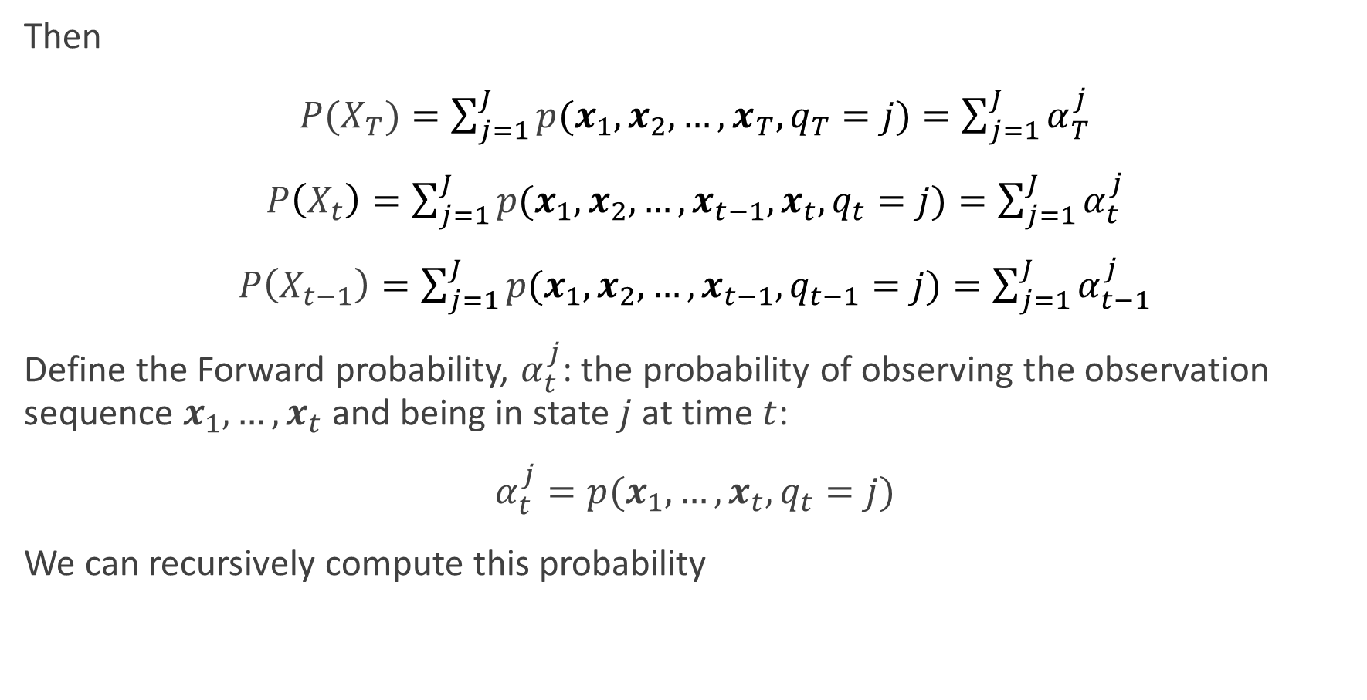
The forward probability
Then
$P(X_{T})=\sum_{j=1}^{J}{p(x_{1},x_{2},…,x_{T},q_{T}=j)}=\sum_{j=1}^{J}{α_{T}^{j}}$
$P\left(X_{t}\right)=\sum_{j=1}^{J}{p(x_{1},x_{2},…,x_{t−1},x_{t},q_{t}=j)}=\sum_{j=1}^{J}{α_{t}^{j}}$
$P\left(X_{t−1}\right)=\sum_{j=1}^{J}{p(x_{1},x_{2},…,x_{t−1},q_{t−1}=j)}=\sum_{j=1}^{J}{α_{t−1}^{j}}$
Define the Forward probability, $α_{t}^{j}$: the probability of observing the observation sequence $x_{1},…,x_{t}$ and being in state $j$ at time $t$:
$α_{t}^{j}=p(x_{1},…,x_{t},q_{t}=j)$
We can recursively compute this probability

Slide 46

Likelihood: The Forward algorithm
The Forward algorithm:
Rather than enumerating each sequence, compute the probabilities recursively (exploiting the Markov assumption)
Reduces the computational complexity to $O(TN^{2})$
Visualize the problem as a state-time trellis
t-1
t
t+1
i
i
i
j
j
j
k
k
k
Notes:
https://www.cs.cmu.edu/~aarti/Class/10701/slides/Lecture17.pdf

Slide 47

Likelihood: The Forward algorithm
Compute $α_{t}^{j}$ for all state $j$, time $t$ using dynamic programming:
Initialization $α_{1}^{j}=P\left(x_{1} | q_{1}=j\right)P(q_{1}=j)$
Iteration
$α_{t}^{j}=p\left(x_{t} | q_{t}=j\right)\sum_{i=1}^{J}{(α_{t−1}^{i}⋅p(q_{t}=j|q_{t−1}=i))},1≤j≤J,1≤t≤T$
Termination $P\left(X\right)=\sum_{j=1}^{J}{α_{T}^{j}}$

Slide 48





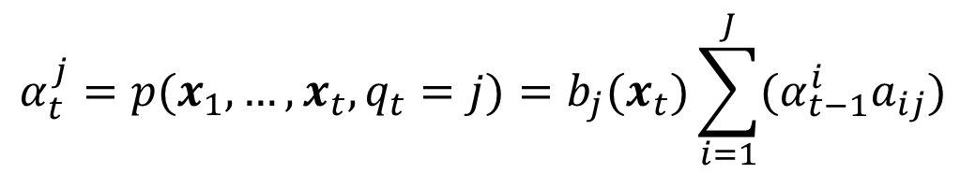









Likelihood: The Forward algorithm
$$α_{t}^{j}=p(x_{1},…,x_{t},q_{t}=j)=b_{j}(x_{t})\sum_{i=1}^{J}{(α_{t−1}^{i}a_{ij})}$$
t-1
t
t+1
i
i
i
$$α_{t−1}^{i}$$
$$a_{ij}$$
$$α_{t}^{i}$$
$$∑$$
j
$$a_{jj}$$
j
j
$$α_{t−1}^{j}$$
$$α_{t}^{j}$$
$$a_{kj}$$
k
k
k
$$α_{t−1}^{k}$$
$$α_{t}^{k}$$
$$b_{j}(x_{t})$$
$$x_{t−1}$$
$$x_{t}$$
$$x_{t+1}$$

Slide 49
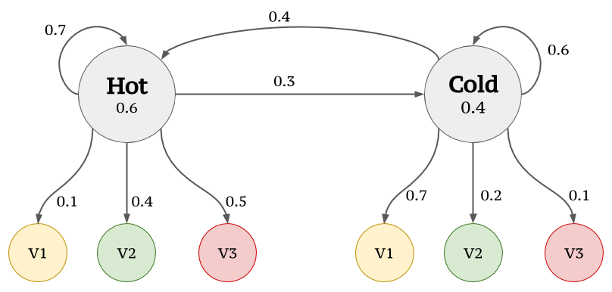

Example: Ice cream
Model parameters:
Observation $Σ=\{v1=1,v2=2,v3=3\}$
Set of states $S=\{ hot, cold\}$
Transition probabilities between any two states $a_{ij}$
Emission probabilities within each state $b_{i}\left(x\right)$
Notes:
https://towardsdatascience.com/markov-and-hidden-markov-model-3eec42298d75

Slide 50

Example: Ice cream
Example Sequence $X=\{v2,v3,v1,v2\}$
Given an HMM model, the probability of $X$?

Slide 51
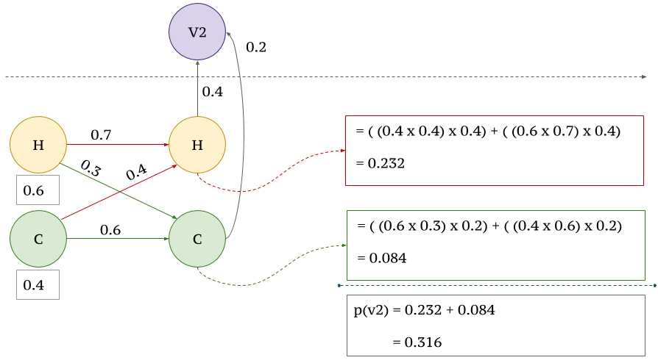

Example: Ice cream
$X_{1}=\{v1\}$

Slide 52
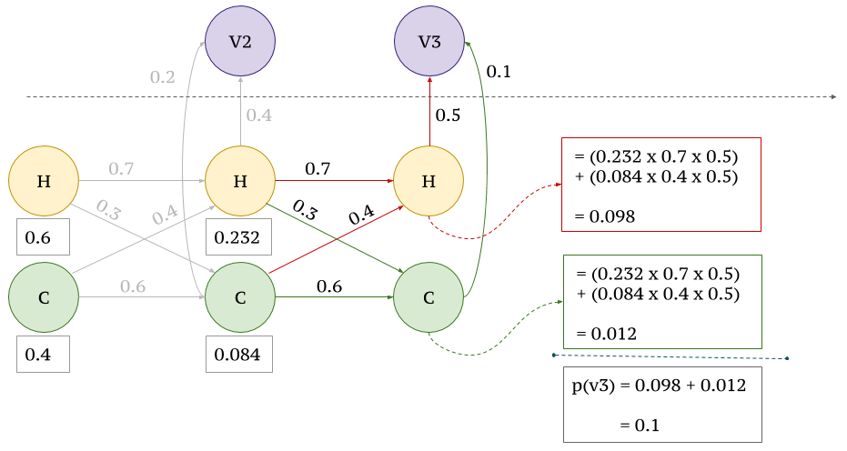

Example: Ice cream
$X_{2}=\{v1,v3\}$

Slide 53


Example: Ice cream
$X_{4}=\{v1,v3,v1,v2\}$

Slide 54
Content
Introduction to HMMs: Hidden Markov models
HMM for ASR
Likelihood computation (forward algorithm)
Finding the most probable state sequence (Viterbi algorithm)
Estimating the parameters (forward-backward and EM algorithms)

Slide 55

The three problems of HMMs
Working with HMMs requires the solution of three problems:
Likelihood Determine the overall likelihood of an observation sequence $X=(x_{1}, …, x_{t} , …, x_{T})$ being generated by a known HMM topology, $ℳ$.
→ the forward algorithm
Decoding and alignment Given an observation sequence and an HMM, determine the most probable hidden state sequence
→ the Viterbi algorithm

Slide 56



Decoding and alignment
Goal: Find the most likely probable hidden state sequence $Q^{∗}=(q_{1}^{∗}, …, q_{T}^{∗})$given an observation sequence $X$
Similar to the likelihood problem,
$V_{T}^{j}$ -- probability of most likely sequence of states ending at state $q_{T}=j$
$$\arg{\max_{Q}{P\left(Q | X\right)=}}\arg{\max_{Q_{T}}{P(Q_{T},X)}}=\arg{\max_{Q_{T}}{p(q_{1},…,q_{T},x_{1},…,x_{T})}}$$
$$\max_{Q_{T}}{p(q_{1},…,q_{T},x_{1},…,x_{T})}=\max_{Q_{T}}{p(q_{1},…,q_{T−1},q_{T},x_{1},…,x_{T})}$$
$$=\max_{j}{\max_{Q_{T−1}}{p(Q_{T−1},q_{T}=j,x_{1},…,x_{T})}}$$
$$V_{T}^{j}$$
Compute recursively
Notes:
How do we find the most likely state history, or state trajectory? (As opposed to the sequence of point-wise most likely states?)

Slide 57



Viterbi decoding
Compute probability $V_{t}^{j}$recursively over $t$
$$\max_{Q_{T}}{p(q_{1},…,q_{T},x_{1},…,x_{T})}=\max_{j}{V_{T}^{j}}$$
$$V_{t}^{j}=\max_{q_{1},…,q_{t−1}}{p(q_{1},…,q_{t−1},q_{t}=j,x_{1},…,x_{t})}$$
$$V_{t−1}^{i}=\max_{q_{1},…,q_{t−2}}{p(q_{1},…,q_{t−2},q_{t−1}=i,x_{1},…,x_{t−1})}$$

Slide 58

Viterbi algorithm
Instead of finding the likelihood over all possible state sequences, as we do in the Forward algorithm, just consider just the most probable path:
$p\left(X,Q^{∗}\right)=\max{p(X,Q)}$
Define likelihood of the most probable partial path in state $j$ at time $t$, $V_{j}(t)$
If we are performing decoding or forced alignment, then only the most likely path is needed
We need to keep track of the states that make up this path by keeping a sequence of backpointers to enable a Viterbi backtrace: the backpointer for each state at each time indicates the previous state on the most probable path

Slide 59






Viterbi recursion
$$V_{t}^{j}=b_{j}(x_{t})\max_{i}\left(V_{t−1}^{i}a_{ij}\right)$$
t-1
t
t+1
i
i
i
$$V_{t−1}^{i}$$
$$a_{ij}$$
$$max$$
j
$$a_{jj}$$
j
j
$$V_{t−1}^{j}$$
$$V_{t}^{j}$$
$$a_{kj}$$
k
k
k
$$V_{t−1}^{k}$$

Slide 60

Viterbi recursion
Backpointers to the previous state on the most probable path
t-1
t
t+1
i
i
i
$$V_{t−1}^{i}$$
$$a_{ij}$$
$$B_{t}^{j}=i$$
j
$$a_{jj}$$
j
j
$$V_{t−1}^{j}$$
$$V_{t}^{j}$$
$$a_{kj}$$
k
k
k
$$V_{t−1}^{k}$$

Slide 61





Decoding: The Viterbi algorithm
Compute $V_{t}^{j}$ for all $j$, $t$ using dynamic programming:
Initialization $V_{1}^{j}=p\left(x_{1} | q_{1}=j\right)p\left(q_{1}=j\right)=b_{j}\left(x_{1}\right)p(q_{1}=j)$
Iteration
Termination
Backtrace pointer
$$V_{t}^{j}=b_{j}(x_{t})\max_{i}{V_{t−1}^{i}a_{ij}}$$
$$P^{∗}=V_{T}=\max_{i}{V_{T}^{i}}$$
$$B_{t}^{j}=\arg{b_{j}(x_{t})\max_{i}\left(V_{t−1}^{i}a_{ij}\right) }$$
$$s_{T}^{∗}=B_{T}=\arg{\max_{i}{V_{T}^{i}}}$$

Slide 62



Viterbi backtrace
Backtrace to find the state sequence of the most probable path
t-1
t
t+1
$$B_{t}^{j}=i$$
i
i
i
$$V_{t−1}^{i}$$
j
j
j
$$V_{t−1}^{j}$$
$$V_{j}(t)$$
k
k
k
$$V_{t−1}^{k}$$
$$B_{t+1}^{k}=j$$

Slide 63
Example: Teacher-mood-model
The observation is a probabilistic function of the state.
Situation:
Your school teacher gave three different types of daily homework assignments:
A: took about 5 minutes to complete
B: took about 1 hour to complete
C: took about 3 hours to complete
Your teacher did not reveal openly his mood to you daily, but you knew that your teacher was either in a bad, neutral, or a good mood for a whole day.
Mood changes occurred only overnight.

Slide 64


Example: Teacher-mood-model
Model parameters:
Observation $Σ=\{A, B,C\}$
Set of states $S=\{ good, neutral, bad\}$
Transition probabilities between any two states $a_{ij}$
Emission probabilities within each state $b_{i}\left(x\right)$

Slide 65
Example: Teacher-mood-model
One week, your teacher gave the following homework assignments:
Questions
What did his mood curve look like most likely that week?
Searching for the most probable path – Viterbi algorithm
Monday | Tuesday | Wednesday | Thursday | Friday
A | C | B | A | C

Slide 66


HMM: Viterbi algorithm
Given
Hidden Markov model: $S,Σ ,a_{ij} , b_{i}\left(x\right)$
Observed symbol sequence $Q=x_{1}x_{2}…x_{n}$.
Most probable path of states that resulted in symbol sequence $Q$.
Let $V_{t}^{j}$ be the probability of the most probable path of the symbol sequence $x_{1},x_{2},…,x_{t}$ ending in state $j$. Then:
$$V_{t+1}^{j}=b_{j}(x_{t+1})\max_{i}{(V_{t}^{i}a_{ij})}$$

Slide 67



HMM: Viterbi algorithm
Matrix $V_{t}^{j}$, where $j∈S$ and $1≤t≤ n$.
Initialization:
Iteration: $V_{t}^{j}=b_{j}\left(x_{t}\right)\max_{i}{(V_{t−1}^{i}∗a_{ij}})$for all states $i,j∈S,t≥2$.
Algorithm
$$V_{1}^{j}=\frac{b_{j}\left(x_{1}\right)}{\#states}$$
Iteratively build up matrix $V_{t}^{j}$.
Store pointers to chosen path.
Probability of most probable path in maximum entry in last column.
Reconstruct path along pointers.

Slide 68

HMM: Viterbi algorithm
Empty table

Slide 69



HMM: Viterbi algorithm
Initialization: $V_{1}^{j}=b_{j}(x_{1})p(q_{1}=j)$
$$V_{1}^{j}=\frac{b_{j}\left(A\right)}{\#states}$$

Slide 70


HMM: Viterbi algorithm
Initialization: $V_{2}^{j}=b_{j}\left(C\right)\max_{i}{(V_{1}^{i}a_{ij})}$

Slide 71


HMM: Viterbi algorithm
Initialization: $V_{3}^{j}=b_{j}\left(B\right)\max_{i}{(V_{3}^{j}a_{ij})}$

Slide 72

HMM: Viterbi algorithm
Maximum entry in last column

Slide 73

HMM: Viterbi algorithm
Reconstruct path along pointers

Slide 74
HMM: Viterbi algorithm
Question
What did his mood curve look like most likely that week?
Answer
Most probable mood curve:
Day | Monday | Tuesday | Wednesday | Thursday | Friday
Assignment | A | C | B | A | C
Mood | good | bad | neutral | good | bad

Slide 75
Content
Introduction to HMMs: Hidden Markov models
HMM for ASR
Likelihood computation (forward algorithm)
Finding the most probable state sequence (Viterbi algorithm)
Estimating the parameters (forward-backward and EM algorithms)

Slide 76



Training: Baum-Welch algorithm
Goal: Efficiently estimate the parameters of an HMM $λ$ from an observation sequence $X$ and known HMM topology $ℳ$:
Parameters $λ$:
Transition probabilities $a_{ij}=p\left(q_{t+1}=j | q_{t}=i\right)$
Observation probabilities $b_{j}\left(x\right)=p\left(x | q=j\right)$
Maximum likelihood training: find the parameters that maximize
$$F_{ML}\left(λ\right)=\log{p(X|λ)}$$
$$=\sum_{x_{i}∈X}{\log{p(x_{i}|λ)}}$$
$$\max_{λ}{F(λ)}$$
Notes:
Notice that in order for learning to be effective, we need lots of data, i.e., many, long observation histories

Slide 77


Pre-requisite: Maximum likelihood estimation
MLE is a method of estimating the parameters of a statistical model given observations, by finding the parameter values that maximize the likelihood of making the observations given the parameters.
Let D_{c} be the set containing all the samples from class c. Suppose these samples are independent and identically distributed (i.i.d), the likelihood of all the samples belonging to D_{c} given a parameter $θ_{c}$ is:
$$p\left(D_{C} | θ_{c}\right)=\prod_{x_{i}∈D_{c}}{p(x_{i}|θ_{c})}$$

Slide 78



Pre-requisite: Maximum likelihood estimation
We want to maximize $p(D_{C}|θ_{c})$
Log-likelihood ($LL(θ_{c})$) often used instead of using $p(D_{C}|θ_{c})$
The maximum likelihood estimation of $θ_{c}$ is
$$LL\left(θ_{c}\right)=\log{p\left(D_{C} | θ_{c}\right)}$$
$$=\sum_{x_{i}∈D_{c}}{\log{p(x_{i}|θ_{c})}}$$
$${\hat{θ}}_{c}=\arg{\max_{θ_{c}}{LL(θ_{c})}}$$

Slide 79



Pre-requisite: Maximum likelihood estimation
Example:
If the probability density function $p\left(x | c\right)\sim 𝒩(μ_{c},Σ_{c})$, the MLE of $μ_{c}$and $Σ_{c}$is
$${\hat{μ}}_{c}=\frac{1}{\left|D_{c}\right|}\sum_{x_{i}∈D_{c}}{x_{i}}$$
$$Σ_{c}=\frac{1}{\left|D_{c}\right|}\sum_{x_{i}∈D_{c}}{\left(x_{i}−{\hat{μ}}_{c}\right){\left(x_{i}−{\hat{μ}}_{c}\right)}^{T}}$$

Slide 80


Training: Baum-Welch algorithm
Goal: Efficiently estimate the parameters of an HMM $λ$ from an observation sequence $X$ and known HMM topology $ℳ$:
Parameters $λ$:
Transition probabilities $a_{ij}=p\left(q_{t+1}=j | q_{t}=i\right)$
Observation probabilities $b_{j}\left(x\right)=p\left(x | q=j\right)$
Maximum likelihood training: find the parameters that maximize
$$F_{ML}\left(λ\right)=\log{p(X|λ)}$$
$$=\sum_{x_{i}∈X}{\log{p(x_{i}|λ)}}$$
$$=\sum_{x_{i}∈X}{\log{\sum_{Q∈𝒬}{p(x_{i},Q|λ)}}}$$
But likelihood doesn’t factorize since observations not i.i.d.
hidden variables – state sequence $Q=[q_{1},…,q_{T}]$
$$\max_{λ}{F(λ)}$$

Slide 81



Pre-requisite: EM algorithm
$$\max_{θ}{\log{\int_{z}{p\left(z,x;θ\right)dz}}}≥\max_{θ}{\int_{z}{q\left(z\right)\log{p\left(z,x;θ\right)}dz}}−\int_{z}{q\left(z\right)\log{q\left(z\right)}dz}$$
Jensen’s Inequality: equality holds when is an affine function
This is achieved for $q\left(z\right)=p(z|x;θ)∝p\left(z,x;θ\right)$
$$f\left(x\right)=\log{\frac{p\left(z,x;θ\right)}{q(z)}}$$
EM Algorithm: Iterate
1. E-step: Compute $q\left(z\right)=p(z|x;θ)$
2. M-step: Compute $θ=\arg{\max_{θ}{\int_{z}{q\left(z\right)\log{p\left(z,x;θ\right)}dz}}}$

Slide 82



EM algorithm in HMM
EM Algorithm:
1. E-step: $q\left(z\right)=p(z|x;θ)$
2. M-step: $θ=\arg{\max_{θ}{\int_{z}{q\left(z\right)\log{p\left(x,z;θ\right)}dx}}}$
If we have some initial parameters $λ_{0}$ and we want to find new parameters to maximize the likelihood $F_{ML}(λ)$, then we can instead maximize
$$\sum_{Q∈𝒬}{p\left(Q | X;λ \right)\log{p(X,Q;λ)}}$$
E-step estimate the state occupation probabilities given the current parameters (Expectation)
M-step re-estimate the HMM parameters based on the estimated state occupation probabilities (Maximization)

Slide 83


EM algorithm in HMM
Application of EM algorithm to HMMs is called Baum-Welch algorithm
E-step – Fix parameters, find states expectation (Forward and Backward algorithm)
M-step – Fix expected states, update parameters
In the initial phase, the content of the parameters $\{a_{ij}\}$ , $\{b_{j}\left(x\right)\}$, $\{a_{0j}\}$ are initialized, and it could be done randomly if there is no prior knowledge about them.
State occupation probability: $γ_{t}^{j}$ is the probability that the system is at state $j$ at time $t$ given the sequence of observations $X$.
We can use this for an iterative algorithm for HMM training
$$γ_{t}^{j}=p\left(q_{t}=j | X;λ\right)=\frac{p\left(q_{t}=j,X\right)}{p\left(X\right)}=\frac{p\left(q_{t}=j,x_{1},…,x_{T}\right)}{p\left(X\right)}$$
Notes:
Maximum likelihood estimation chooses the state with the highest probability at the “best” estimate at each time step
these are pointwise best estimate: the sequence of maximum likelihood estimates is not necessarily a good (or feasible) trajectory for the HMM!

Slide 84


EM algorithm in HMM
Application of EM algorithm to HMMs is called Baum-Welch algorithm
E-step – Fix parameters, find states expectation (Forward and Backward algorithm)
M-step – Fix expected states, update parameters
Remember we have $α_{t}^{j}=p\left(x_{1},x_{2},…,x_{t},q_{t}=j\right)$ (Forward probability)
We need something for the second part: mirror image of the “forward procedure”, called “backward procedure.”
Let $β_{t}^{j}=p(x_{t+1},…,x_{T}|q_{t}=j)$ (Backward probability)
$α_{t}^{j}β_{t}^{j}=p\left(x_{1},…,x_{t},q_{t}=j\right)p\left(x_{t+1},…, x_{T} | q_{t}=j\right)$
$=p(x_{1},…,x_{t},x_{t+1},…,x_{T},q_{t}=j)$
$=p(X,q_{t}=j)$
$$γ_{t}^{j}=p\left(q_{t}=j | X\right)$$
$$=\frac{p({X,q}_{t}=j)}{p\left(X\right)}$$
$$=\frac{α_{t}^{j}β_{t}^{j}}{\sum_{j}^{J}{α_{t}^{j}β_{t}^{j}}}$$
Notes:
The forward and the backward phase form the E-step of the EM algorithm, while the update phase itself is the M-step.

Slide 85

E step: Forward algorithm
Estimate the state occupation probabilities given the current parameters (Expectation)
Determine the likelihood of an observation sequence $X_{t}=(x_{1}, …, x_{t} , …, x_{t})$ being generated by a known HMM topology, $ℳ$.
Compute $α_{t}^{j}$ for all state $j$, time $t$ using dynamic programming:
Initialization $α_{1}^{j}=p\left(x_{1} | q_{1}=j\right)p(q_{1}=j)$
Iteration $α_{t}^{j}=b_{j}(x_{t})\sum_{i=1}^{J}{(α_{t−1}^{i}⋅a_{ij})},1≤j≤J,1≤t≤T$

Slide 86

E step: Backward algorithm
To estimate the state occupation probabilities it is useful to define (recursively) another set of probabilities—the Backward probabilities
$β_{t}^{j}=p\left(x_{t+1},…,x_{T}|q_{t}=j\right)$
Given an HMM, $β_{t}^{j}$is the probability of future observations in state $j$ at time $t$
These can be recursively computed (going backwards in time)
Initialization: $β_{T}^{j}=1 for j=1,…,J$
Recursion
$$β_{t−1}^{j}=\sum_{i=1}^{J}{a_{ji}b_{i}\left(x_{t}\right)β_{t}^{i}} for t=T−1,…,1$$
Termination
$$p\left(X\right)=\sum_{i=1}^{J}{a_{0i}b_{i}\left(x_{1}\right)β_{1}^{i}}$$

Slide 87









E step: Backward algorithm
$$β_{t}^{j}=p(x_{t+1},…,x_{T}|q_{t}=j)=\sum_{i=1}^{J}{a_{ji}b_{j}\left(x_{t+1}\right)β_{t+1}^{i}}$$
t-1
t
t+1
i
i
i
$$a_{ji}$$
$$β_{t+1}^{i}$$
$$∑$$
j
j
$$a_{jj}$$
j
$$β_{t}^{j}$$
$$β_{t+1}^{j}$$
$$a_{jk}$$
k
k
k
$$β_{t+1}^{k}$$

Slide 88


State occupation probability
The state occupation probability $γ_{t}^{j}$ is the probability of the system being state $j$ at time $t$ given the sequence of observations $X$
Express in terms of the forward and backward probabilities:
$$γ_{t}^{j}=p\left(q_{t}=j | X\right)=\frac{α_{t}^{j}β_{t}^{j}}{p\left(X\right)}=\frac{α_{t}^{j}β_{t}^{j}}{\sum_{j=1}^{J}{α_{t}^{j}β_{t}^{j}}}$$

Slide 89


State occupation probability
The state occupation probability $γ_{t}^{j}$ is the probability of the system being state $j$ at time $t$ given the sequence of observations $X$
Express in terms of the forward and backward probabilities:
New concept: how many times is the state trajectory expected to transition from state $j$?
$$γ_{t}^{j}=p\left(q_{t}=j | X\right)=\frac{α_{t}^{j}β_{t}^{j}}{p\left(X\right)}=\frac{α_{t}^{j}β_{t}^{j}}{\sum_{j=1}^{J}{α_{t}^{j}β_{t}^{j}}}$$
$$E\left[\text{\# }\text{of} \text{transitions} \text{from} \text{state} j\right]=\sum_{t=1}^{T−1}{γ_{t}^{j}}$$

Slide 90



M step: Re-estimation of transition probabilities
Similarly to the state occupation probability, we can estimate $ξ_{t}^{\left(i,j\right)}$, the probability of the system in state $i$ at time $t$ and $j$ at $t+1$, given the observations:
New concept: how many times it the state trajectory expected to transition from state $i$ to state $j$?
$$ξ_{t}^{\left(i,j\right)}=p\left(q_{t}=i,q_{t+1}=j | X\right)$$
$$=\frac{p(q_{t}=i,q_{t+1}=j,X)}{p(X)}$$
$$=\frac{α_{t}^{i}a_{ij}b_{j}\left(x_{t+1}\right)β_{t+1}^{j}}{\sum_{j=1}^{J}{α_{t}^{j}β_{t}^{j}}}$$
$$E\left[\text{\# }\text{of} \text{transitions} \text{from} \text{state} i \text{to} \text{state} j\right]=\sum_{t=1}^{T−1}{ξ_{t}^{\left(i,j\right)}}$$

Slide 91



M step: Re-estimation of transition probabilities
We can use this to re-estimate the transition probabilities
Re-estimate the observation probabilities $b_{j}(x)$
$${\hat{a}}_{ij}=\frac{E\left[\text{\# }\text{of} \text{transitions} \text{from} i \text{to} j\right]}{E\left[\text{\# }\text{of} \text{transitions} \text{from} i\right]}=\frac{\sum_{t=1}^{T−1}{ξ_{t}^{\left(i,j\right)}}}{\sum_{t=1}^{T−1}{γ_{t}^{i}}}$$
$${\hat{b}}_{j}\left(x\right)=\frac{E\left[\text{\# }\text{of} \text{times} \text{in} \text{state} j \text{and} \text{the} \text{observation} \text{is} x_{t}\right]}{E\left[\#\text{of} \text{times} \text{in} \text{state} j\right]}$$
$$=\frac{\sum_{t=1}^{T}{γ_{t}^{j}⋅1(x=x_{t})}}{\sum_{t=1}^{T}{γ_{t}^{j}}}$$

Slide 92

Baum-Welch algorithm
Iterative estimation of HMM parameters using the EM algorithm. At each iteration
E step For all time-state pairs
Recursively compute the forward probabilities $α_{t}^{j}$ and backward probabilities $β_{t}^{j}$
Compute the state occupation probabilities $γ_{t}^{j}$ and $ξ_{t}^{(i,j)}$
M step Based on the estimated state occupation probabilities re-estimate the HMM parameters: transition probabilities $a_{ij}$ and parameters of the observation probabilities, $b_{j}(x)$
$a_{ij}=\frac{\sum_{t=1}^{T}{ξ_{t}^{\left(i,j\right)}}}{\sum_{k=1}^{J}{\sum_{t+1}^{T}{ξ_{t}^{(i,k)}}}}$
$b_{j}\left(x\right)=\frac{\sum_{t=1}^{T}{γ_{t}^{j}⋅1(x=x_{t})}}{\sum_{t=1}^{T}{γ_{t}^{j}}}$
The application of the EM algorithm to HMM training is sometimes called the Forward-Backward algorithm or Baum-Welch algorithm

Slide 93
Summary: HMMs
HMMs provide a generative model for statistical speech recognition
Three key problems
Computing the overall likelihood: the Forward algorithm
Decoding the most likely state sequence: the Viterbi algorithm
Estimating the most likely parameters: the EM (Forward-Backward) algorithm
Solutions to these problems are tractable due to the two key HMM assumptions
Conditional independence of observations given the current state
Markov assumption on the states

